Slide 1

Sustainable Development
JC Gibbs
Applied Business and Technology
Kansas State University
27 September 2021
Notes:
This file presents an assertion-evidence template for making effective slides for scientific presentations. Although much about the layout and typography contrasts sharply with the defaults of PowerPoint, these changes are done so to make the slides more effective at communicating technical information. The design advocated by this template arises from Chapter 4 of The Craft of Scientific Presentations, 2nd edition (Springer, 2013). The homepage for this template exists at the following website:
http://writing.engr.psu.edu/assertion_evidence.html
Right now you are viewing the notes pages. To work on the slides, click on “Slide” under “View.” Tip: When creating a new presentation, save this file as the name of your presentation. Warning: You are more than welcome to use this template for your presentation slides. You may not, though, distribute this template for profit or distribute this template without giving credit to the source: http://writing.engr.psu.edu/
This slide is for the title slide of a presentation. Consider inserting an image that helps orient the audience to the title. You should not leave this slide until the audience feel comfortable with the title. Forcing yourself to spend more time with this slide is good because a common mistake in presentations is to leave the title slide too soon. Because of this mistake, many in the audience do not have the chance to comprehend the key details of the title. See pages 172-184 in The Craft of Scientific Presentations, 2nd ed. (CSP).
This template shows one layout for the slide. You might want to rearrange the placement of the body’s wording to accommodate a different sized image. On the next slide is a sample title slide. You should delete the examples after you create your own slides.

Slide 2
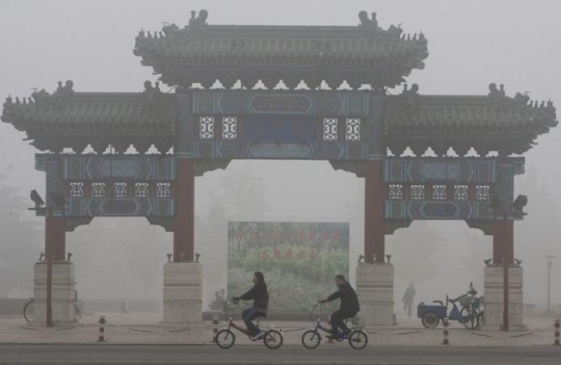
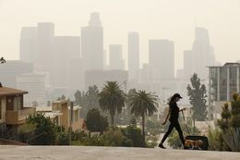
Since historical times, air pollution has been a matter of concern.
Notes:
Sample title slide.
Reference:
Katrina Aspmo, Torunn Berg, and Grethe Wibetoe, “Atmospheric Mercury Depletion Events (AMDEs) in Polar Regions During Arctic Spring,” presentation (Oslo, Norway: University of Oslo, 16 June 2004).

Slide 3
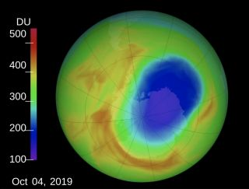
Ozone is toxic and is harmful to health when generated near the Earth's surface.
The ozone hole (blue) can be seen here over Antarctica on Oct. 4, 2019. (Image credit: NASA Goddard/Katy Mersmann)
Notes:
Sample mapping slide.
Reference:
Katrina Aspmo, Torunn Berg, and Grethe Wibetoe, “Atmospheric Mercury Depletion Events (AMDEs) in Polar Regions During Arctic Spring,” presentation (Oslo, Norway: University of Oslo, 16 June 2004).

Slide 4
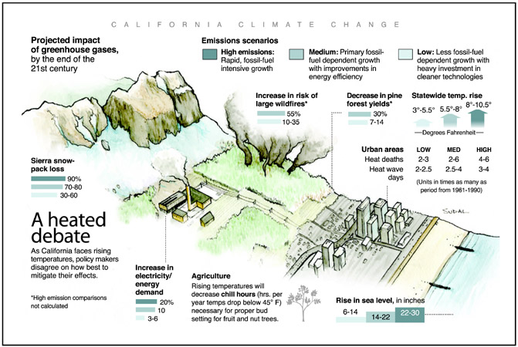
Greenhouse gas emissions impact
This graphic from the Associated Press shows the projected impacts of greenhouse gases on California by the end of the 21st century. Union of Concerned Scientists. AP Images.
Notes:
Sample mapping slide.
Reference:
Katrina Aspmo, Torunn Berg, and Grethe Wibetoe, “Atmospheric Mercury Depletion Events (AMDEs) in Polar Regions During Arctic Spring,” presentation (Oslo, Norway: University of Oslo, 16 June 2004).

Slide 5
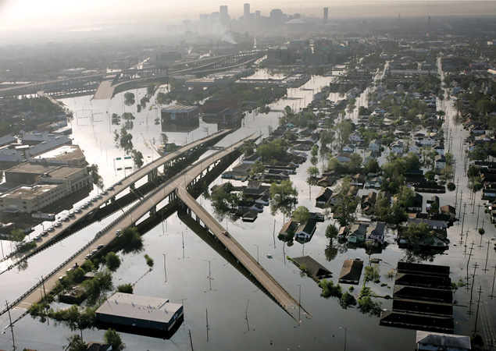
Unpredictable weather patterns can lead to flash flooding
Notes:
Body slide from the first section of the presentation’s middle. Consider having the first-topic image from the mapping slide repeated here. Use the headline (no more than two lines) to make an assertion about this topic. In the body of the slide, support that headline with images and with words, if necessary. See Chapter 4 of The Craft of Scientific Presentations, 2nd ed.
This slide shows one orientation for the image and text in the body of the slide. Other orientations appear in this template. Choose the one that best supports your headline assertion.
Some institutions will insist that you place an institutional logo on each slide. Other institutions recommend a logo on the first slide and the last. If you do place a logo on each slide, make sure that logo is at the bottom of the slide rather than the top. Placing the logo at the top (the place on a slide that receives the most emphasis) shifts the emphasis away from the work.

Slide 6
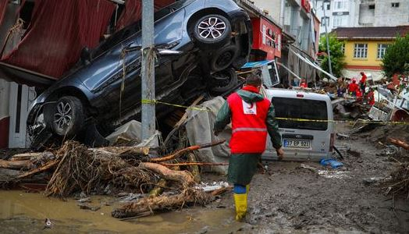
Severe storm patterns are seen across the world

Slide 7
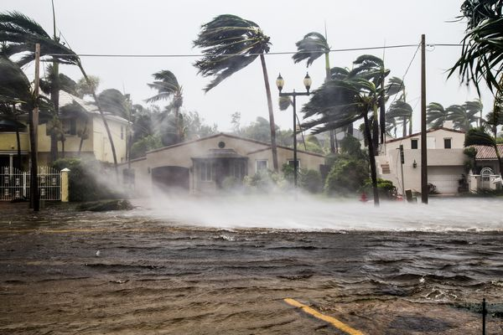
Climate changes has influenced some of the deadliest storm
A flooded street after catastrophic Hurricane Irma hit Fort Lauderdale, FL.

Slide 8
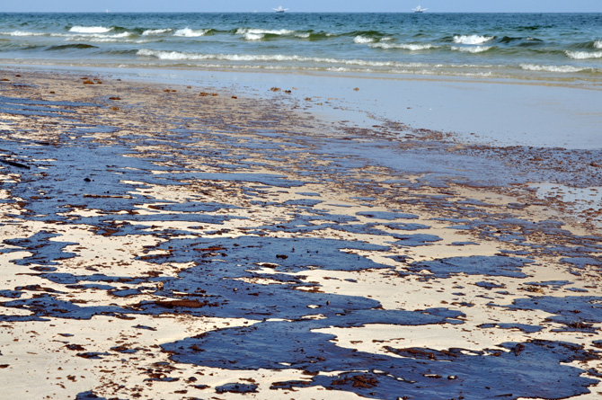
Many man made disaster are recking havoc on our planet
Oil from the Deepwater Horizon oil spill is shown on a beach on June 12, 2010, in Gulf Shores, Alabama
Notes:
Blank slide for drafting a body slide.

Slide 9
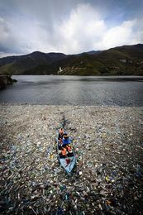

Plastics are a major problem. It does not decay but breaks down into smaller pieces that end up in our ocean.
microplastics
Notes:
Sample slide from second section of the presentation’s middle. The image was such that there was no need for subordinate descriptions.
Reference:
Jared Rochester, “Three Primary Products of an Explosive,” presentation (Aberdeen, MD: US Army Research Laboratory, 5 December 2005).

Slide 10
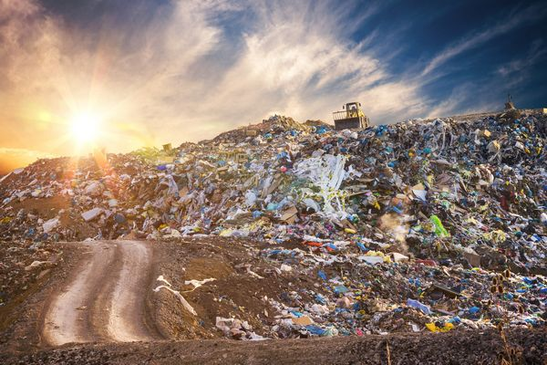
Poor waste management
Garbage pile in trash dump or landfill.

Slide 11
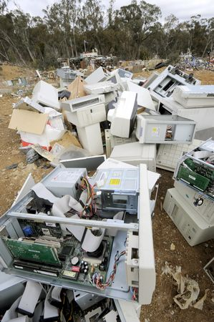
Electronic waste
Notes:
Blank slide for drafting mapping slide

Slide 12
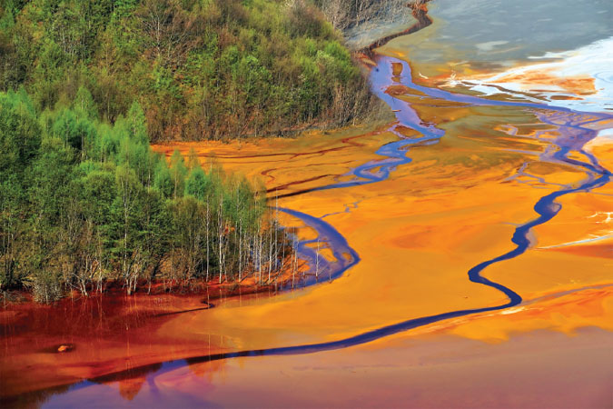
Water pollution
Water pollution from a copper mine. Industrial and agricultural emissions of chemicals into freshwater deplete global supplies of clean drinking water.
Notes:
Blank slide for drafting mapping slide

Slide 13
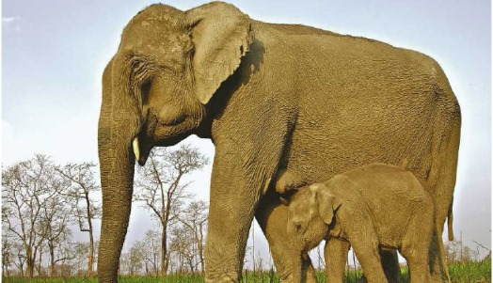
Habitat Fragmentation
Human activity, cause habitat areas to be divided into smaller and smaller pieces. This process has profound implications for species living there

Slide 14
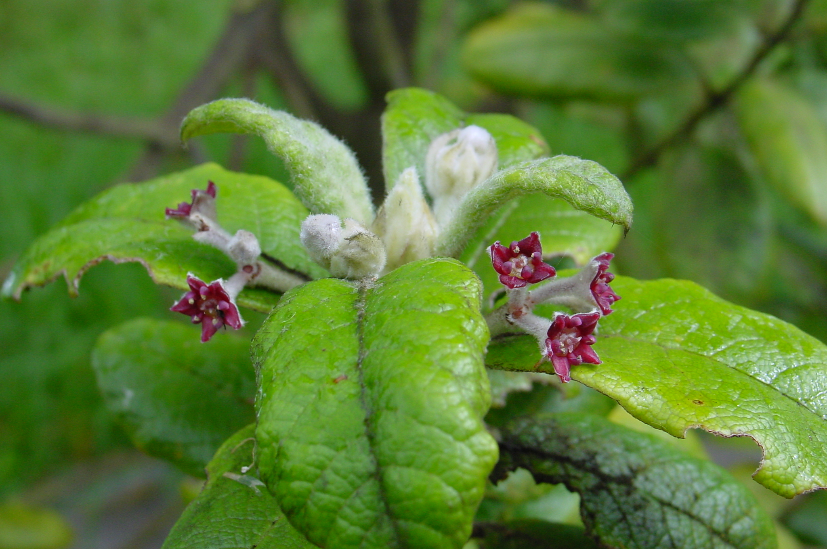
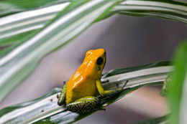
Due to human strains, plants, animals, and invertebrates are becoming extinct at an unprecedented rate.
The extinct St Helena Olive Credit: Rebecca Cairns-Wicks
Poison dart frog

Slide 15
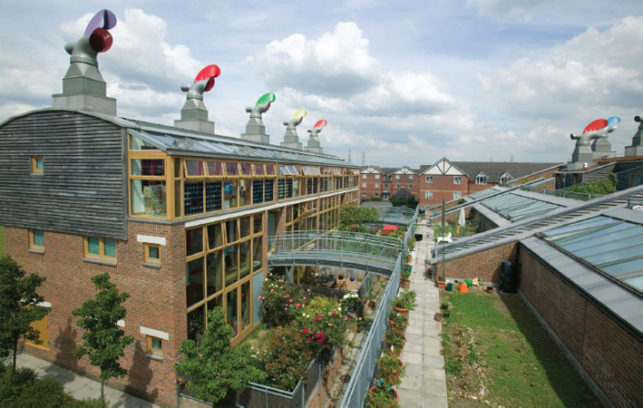
Thinking green can facilitate sustainable growth everywhere.
Notes:
Body slide from the second section of the presentation’s middle. For the first body slide of this second section, consider repeating the corresponding image (or equation) from the mapping slide. Use the headline to make an assertion about this topic. In the body of the slide, support that headline assertion with images and needed callouts. See Chapter 4 of The Craft of Scientific Presentations, 2nd ed.
This slide shows one orientation for the image and text in the body of the slide. Other orientations appear in this template. Choose the orientation that best supports your headline assertion.

Slide 16
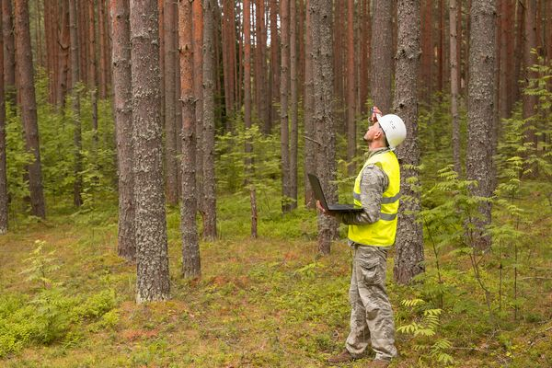
Sustainable forestry is managing, using, and conserving forests & associated wildlife, water, and other resources in a sustainable way.
Notes:
Blank slide for drafting a body slide.

Slide 17
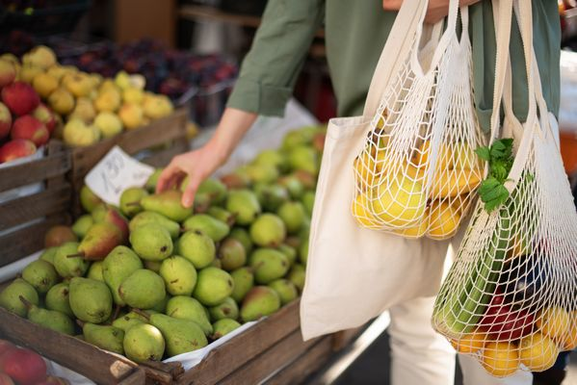
Reduce Reuse and Recycle

Slide 18
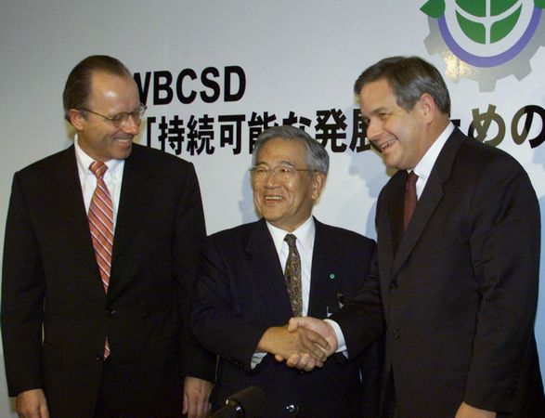
The World Business Council for Sustainable Development (WBCSD) is commited to building a sustainable future.
Notes:
Body slide from the third section of the presentation’s middle. For the first body slide of this third section, consider repeating the corresponding image from the mapping slide. Use the headline to say state an assertion about this topic. In the body of the slide, support that headline with images and with needed callouts. See Chapter 4 of The Craft of Scientific Presentations, 2nd ed..
This slide shows one orientation for the image and text in the body of the slide. Other orientations appear in this template. Choose the orientation that best supports your headline assertion.

Slide 19
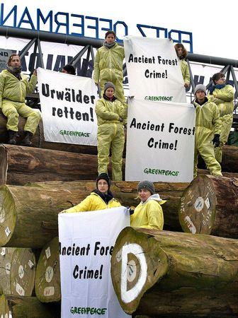
Will take a world wide effort to save our planet.
Notes:
Blank slide for drafting a body slide.

Slide 20
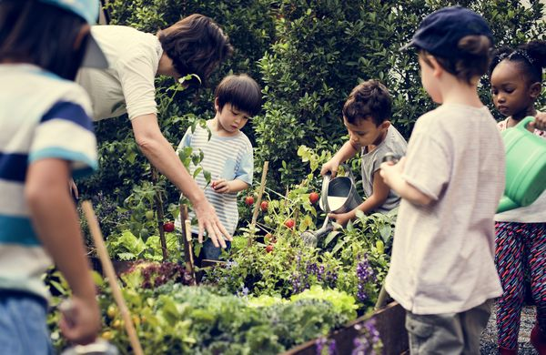
Teaching green habits in school will lead to greener habits later.

Slide 21
A poisonous frog (Phyllobates bicolor) is shown in Santa Fe Zoo, in Medellin, Colombia [Photograph]. (2014). K. L. Lerner & B. W. Lerner (Eds.), The Gale Encyclopedia of Science (5th ed.). Gale. https://link.gale.com/apps/doc/PC4205138630/GRNR?u=ksu&sid=bookmark-GRNR&xid=5ce0e8cb Air pollution. (2011). In D. S. Blanchfield (Ed.), Environmental Encyclopedia. Gale. https://link.gale.com/apps/doc/CV2644150041/GRNR?u=ksu&sid=bookmark-GRNR&xid=1c47e7f2 Blackwell, A. H. (2018). Microplastics. In Gale Environmental Studies Online Collection. Gale. https://link.gale.com/apps/doc/UGXXWM237063901/GRNR?u=ksu&sid=bookmark-GRNR&xid=30644c7d Blackwell, A. H. (2021). Plastic Pollution. In Gale Environmental Studies Online Collection. Gale. https://link.gale.com/apps/doc/PHMJOK207422989/GRNR?u=ksu&sid=bookmark-GRNR&xid=1f125778 Flooding. (2011). In D. S. Blanchfield (Ed.), Environmental Encyclopedia. Gale. https://link.gale.com/apps/doc/CV2644150550/GRNR?u=ksu&sid=bookmark-GRNR&xid=ab892f37 Gale. https://link.gale.com/apps/doc/PC4205136863/GRNR?u=ksu&sid=bookmark-GRNR&xid=32bb2797

Slide 22
Gilman, L. (2008). Greenhouse Gases. In B. W. Lerner & K. L. Lerner (Eds.), In Context Series. Climate Change: In Context (Vol. 1, pp. 473-479). Gale. https://link.gale.com/apps/doc/CX3079000134/GRNR?u=ksu&sid=bookmark-GRNR&xid=4f4fb420 Greenpeace Activists Protest the Trade of Ancient Forest Wood from Central and West Africa [Photograph]. (2009). Gale Environmental Studies Online Collection. Gale. https://link.gale.com/apps/doc/VTXTKB962065624/GRNR?u=ksu&sid=bookmark- GRNR&xid=2367b3d5 Gulf Oil spill is shown on a beach on June 12, 2010 in Gulf Shores, Alabama [Photograph]. (2012). B. W. Lerner & K. L. Lerner (Eds.), In Context Series. Biotechnology: In Context. Gale. https://link.gale.com/apps/doc/PC4205136863/GRNR?u=ksu&sid=bookmark-GRNR&xid=32bb2797 Habitat fragmentation. (2011). In D. S. Blanchfield (Ed.), Environmental Encyclopedia. Gale. https://link.gale.com/apps/doc/CV2644150665/GRNR?u=ksu&sid=bookmark-GRNR&xid=54124518

Slide 23
Hurricanes [Photograph]. (2020). Gale Environmental Studies Online Collection. Gale. https://link.gale.com/apps/doc/STNRWY067850886/GRNR?u=ksu&sid=bookmark- GRNR&xid=44e8cea2 Obsolete Computers and Accessories at a Landfill [Photograph]. (2009). Gale Environmental Studies Online Collection. Gale. https://link.gale.com/apps/doc/STIRGQ542861533/GRNR?u=ksu&sid=bookmark-GRNR&xid=ce9b381b Sustainable development. (2011). In D. S. Blanchfield (Ed.), Environmental Encyclopedia. Gale. https://link.gale.com/apps/doc/CV2644151343/GRNR?u=ksu&sid=bookmark-GRNR&xid=853d7ad3 Sustainable Forestry [Photograph]. (2021). Gale Environmental Studies Online Collection. Gale. https://link.gale.com/apps/doc/XPTHOL373789609/GRNR?u=ksu&sid=bookmark- GRNR&xid=9b6d5281

Slide 24
Waste Disposal: Landfill [Photograph]. (2021). Gale Environmental Studies Online Collection. Gale. https://link.gale.com/apps/doc/ODYMFO324265732/GRNR?u=ksu&sid=bookmark-GRNR&xid=a00944ac Waste Reduction [Photograph]. (2021). Gale Environmental Studies Online Collection. Gale. https://link.gale.com/apps/doc/QFAWAI521002937/GRNR?u=ksu&sid=bookmark- GRNR&xid=66621284 Water pollution from a copper mine. Industrial and agricultural emissions of chemicals Into... [Photograph]. (2011). B. W. Lerner & K. L. Lerner (Eds.), In Context Series. Food: In Context (Vol. 2). Gale. https://link.gale.com/apps/doc/PC1918687309/GRNR?u=ksu&sid=bookmark-GRNR&xid=b2e72e23 World Business Council for Sustainable Development Meeting [Photograph]. (2009). Gale Environmental Studies Online Collection. Gale. https://link.gale.com/apps/doc/CWFFQR378247511/GRNR?u=ksu&sid=bookmark-GRNR&xid=0cd47a0f

